Slide 1
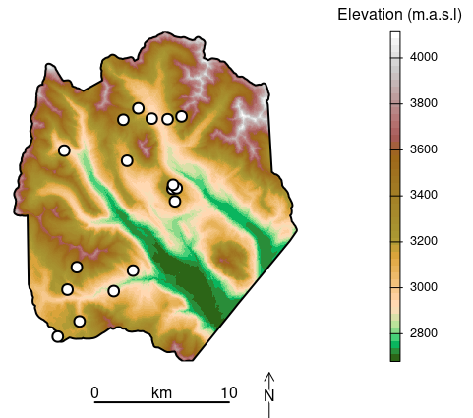
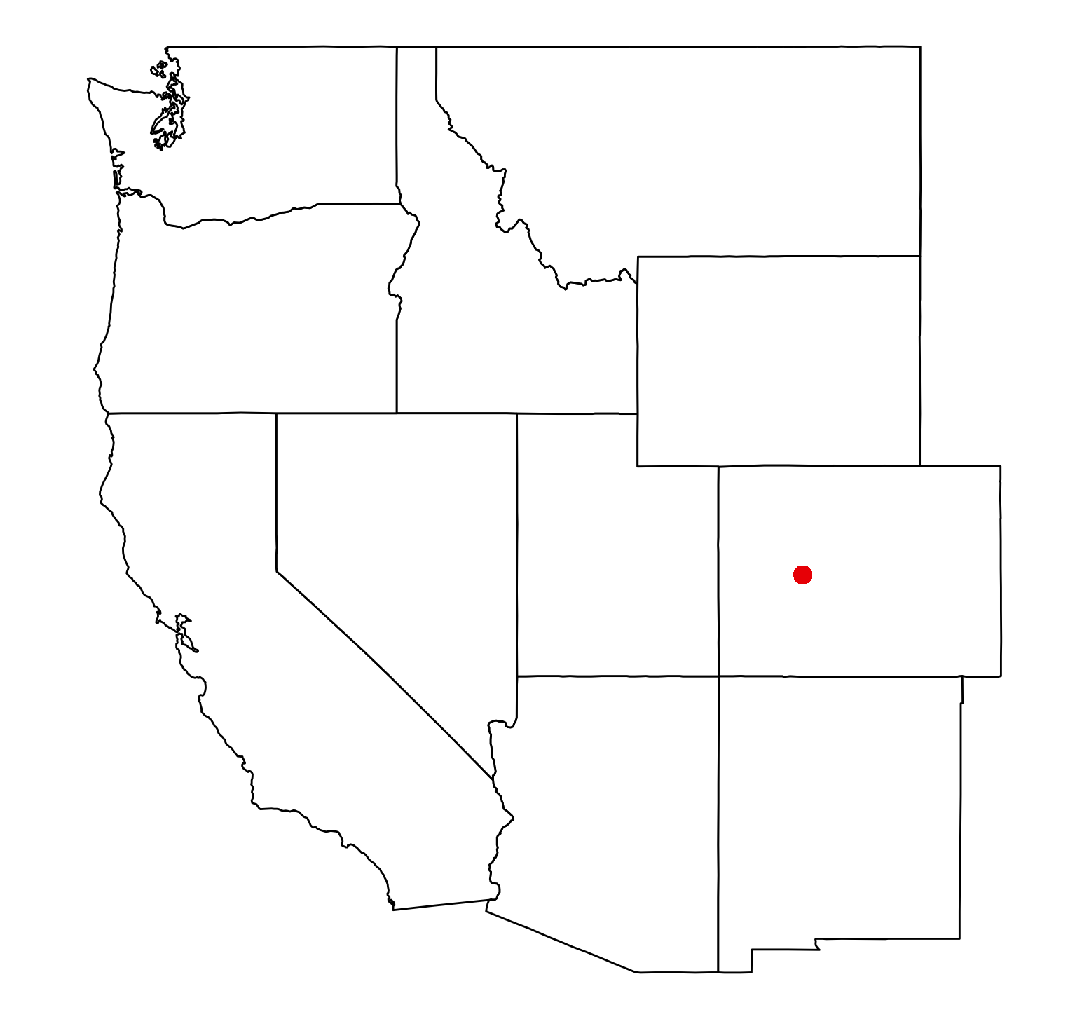
10 point fontz

Slide 2
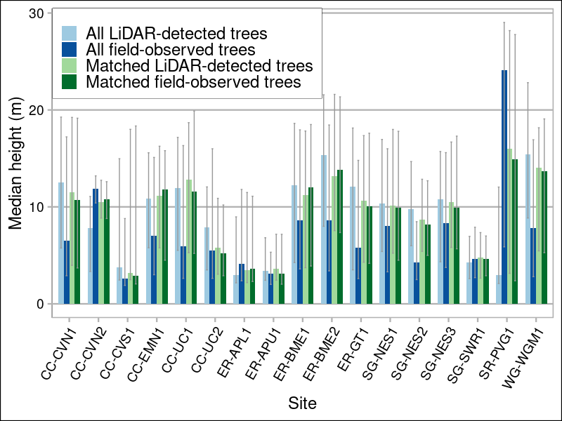
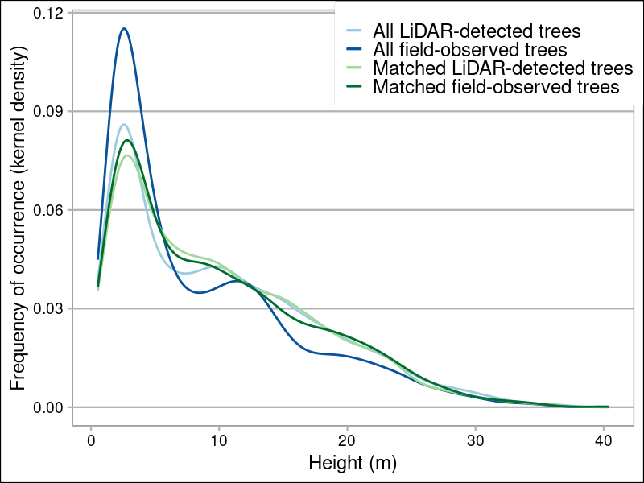
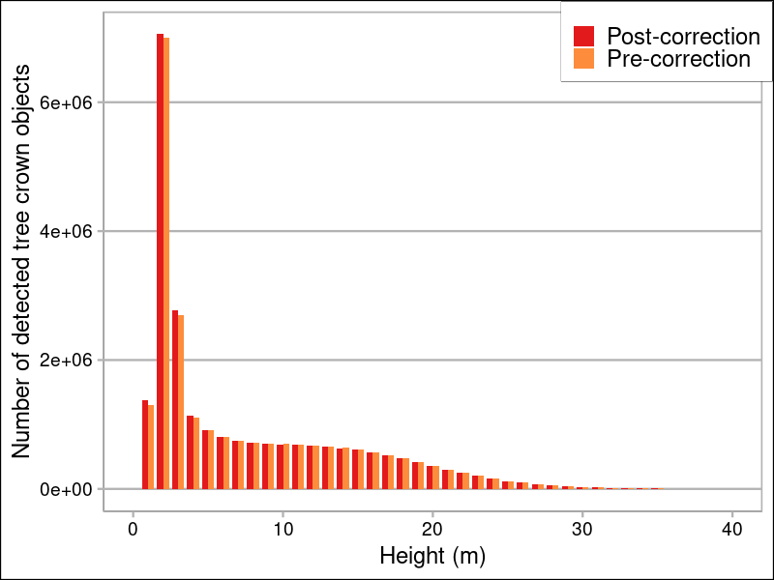
A
B
C

Slide 3
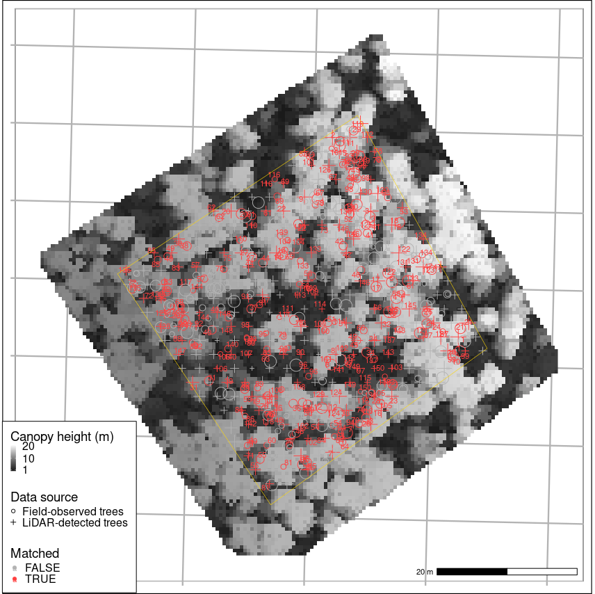
10 point font

Slide 4
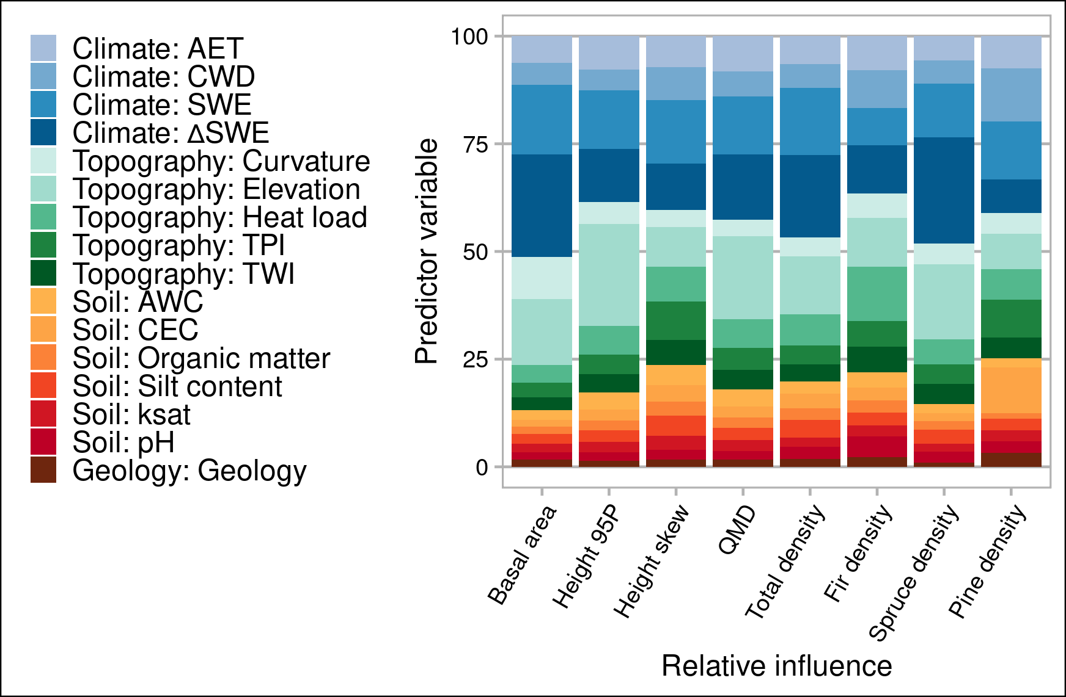
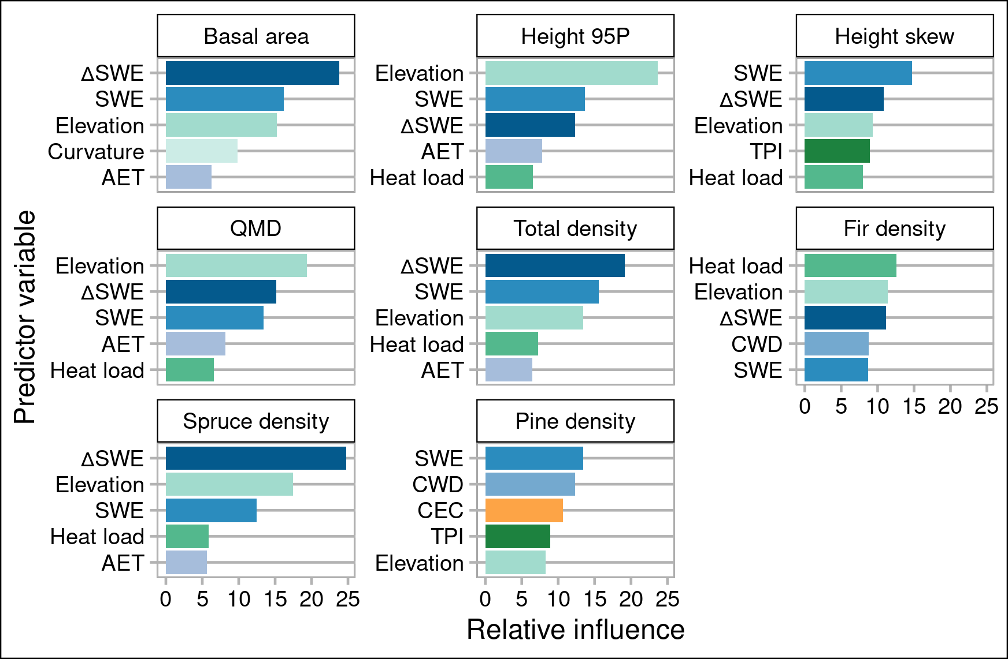
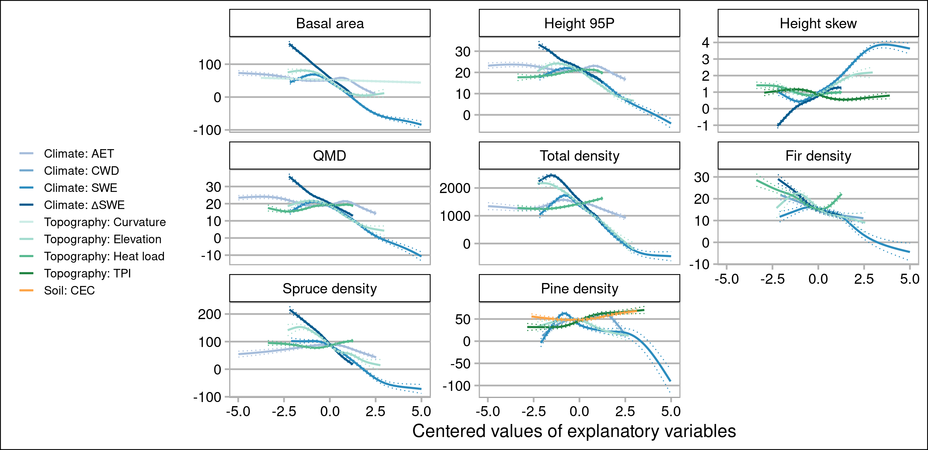
A
B
7 point Arial
10 point Arial

Slide 5
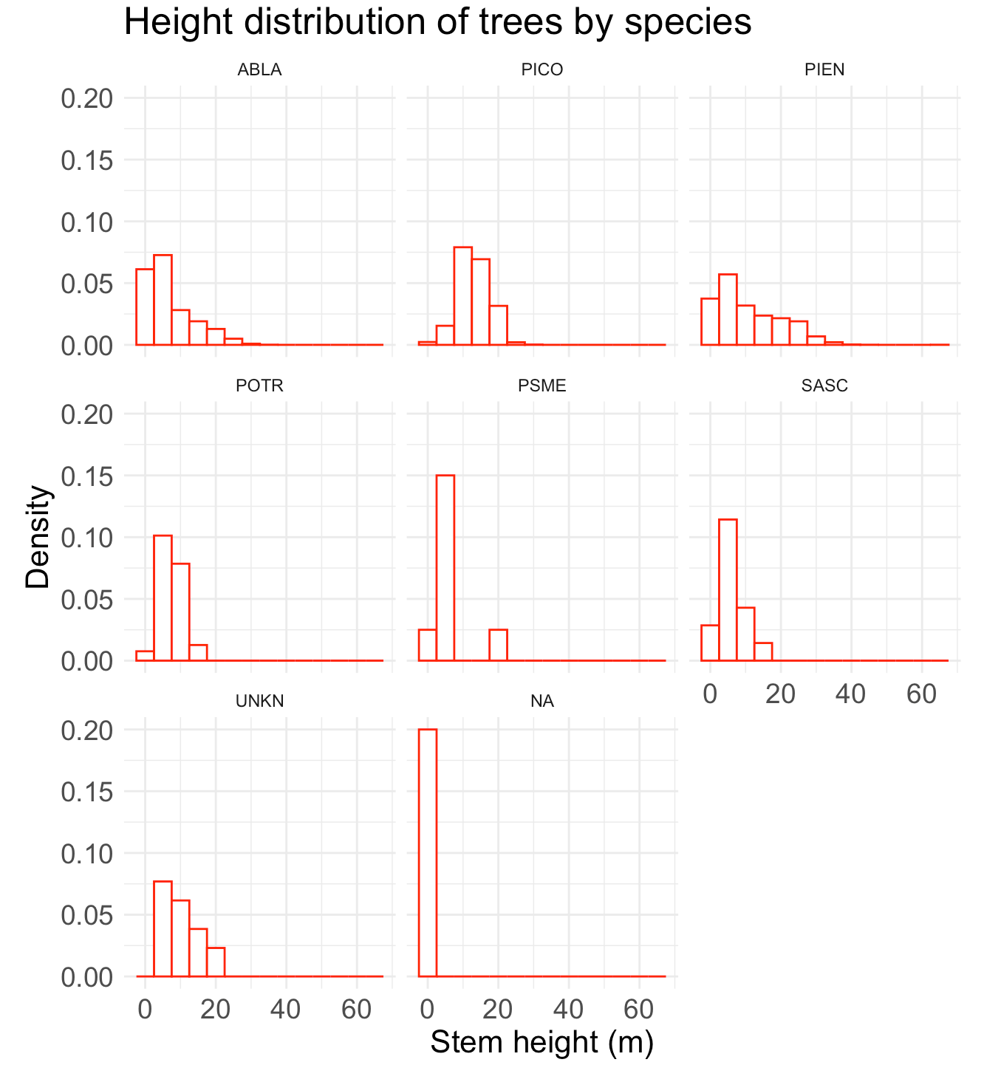
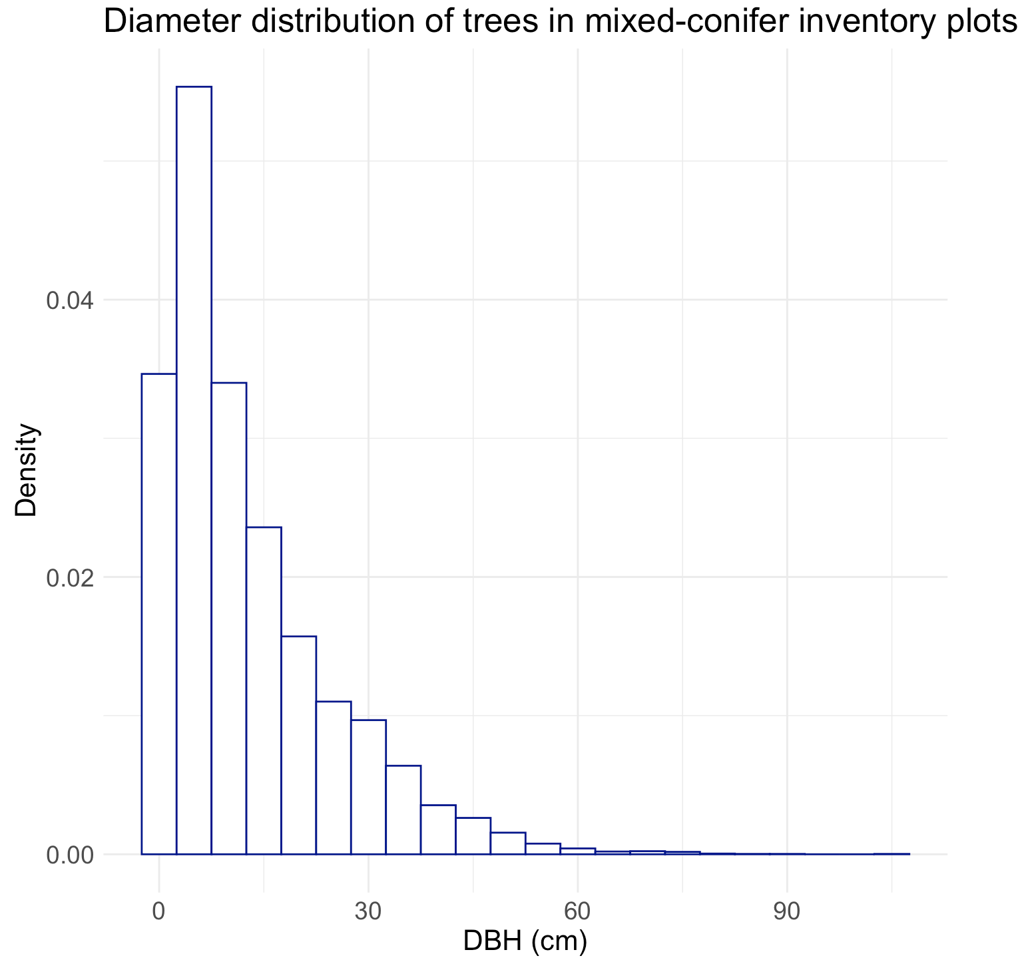
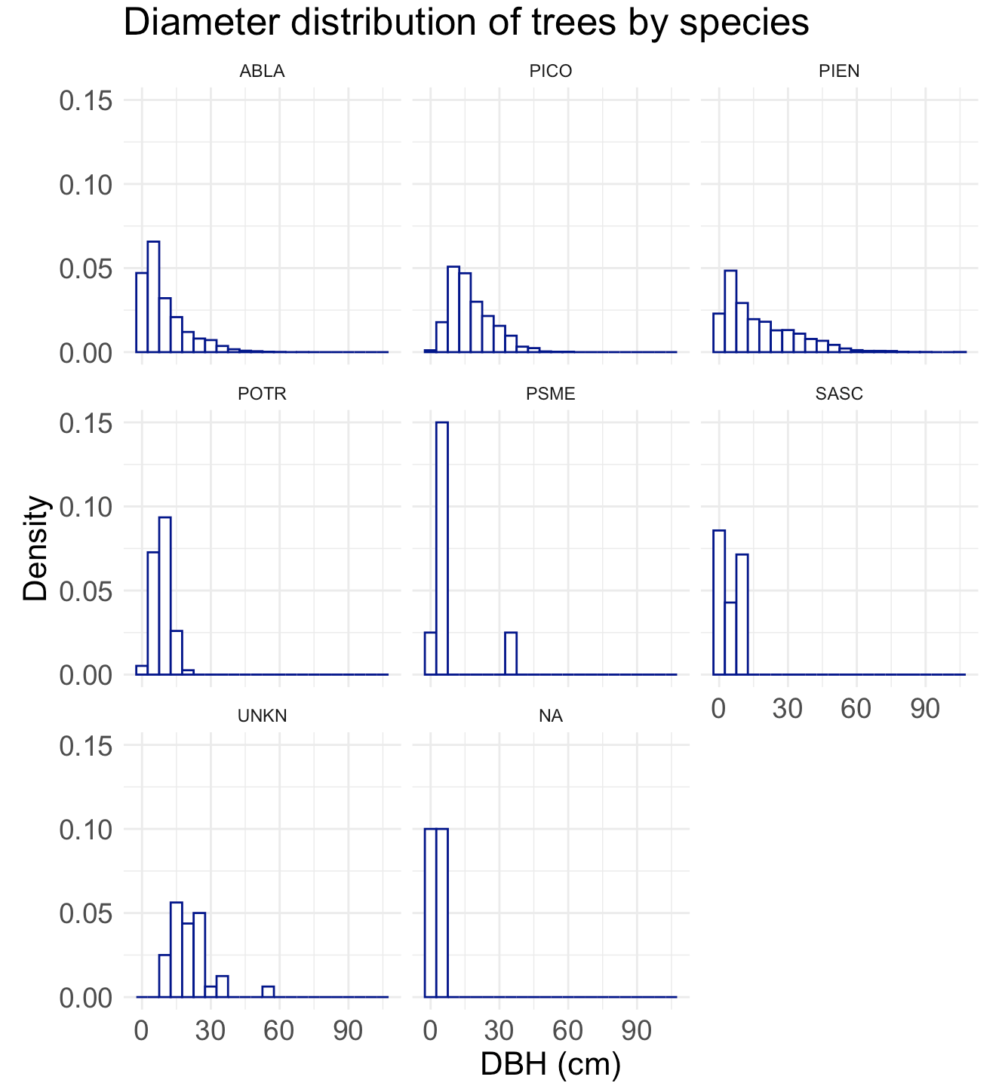
(B)
(A)
(C)
Notes:
Arrange in order of presentation in paper
Intermix tables and figures in planned order
Write question and answer that figure is providing evidence for at top of slide
Make sure it’s all live trees
Drop POTR, SASC
Drop UNKN, NA

Slide 6
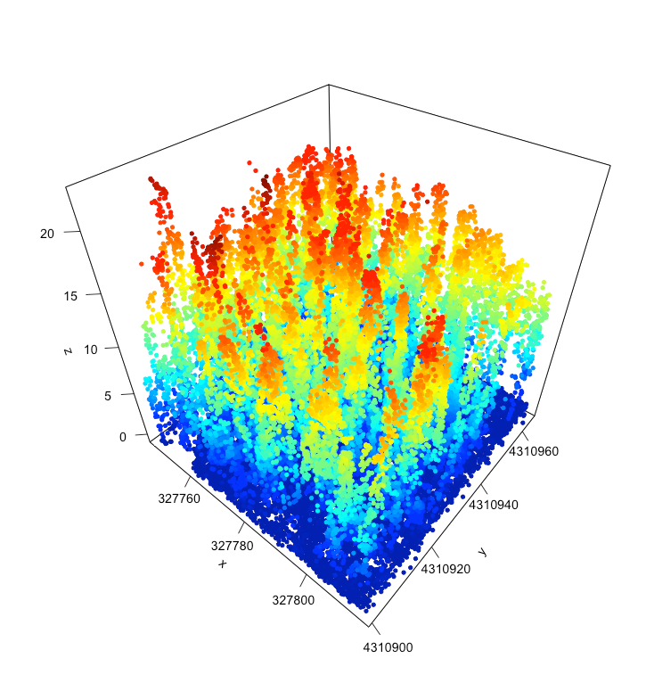
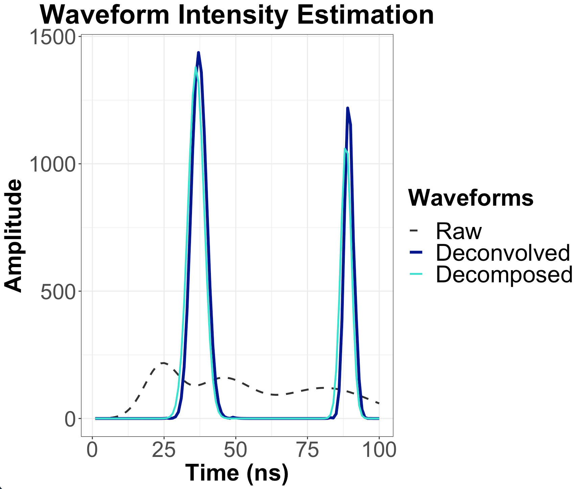
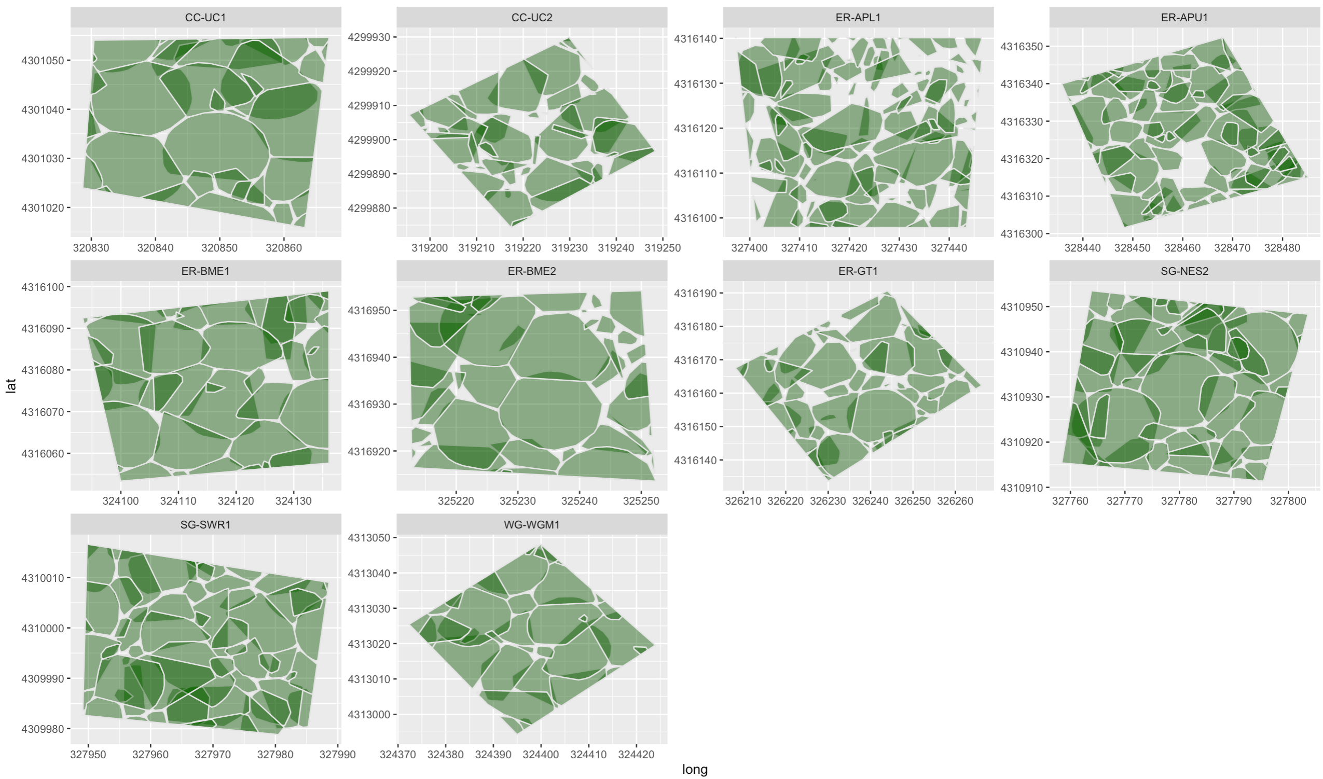
Point cloud from waveform
Individual tree segmentation
(A)
(B)
(C)
Notes:
Add figure for point density at vertical height bands, either at plot, all plots, or full forested domain

Slide 7
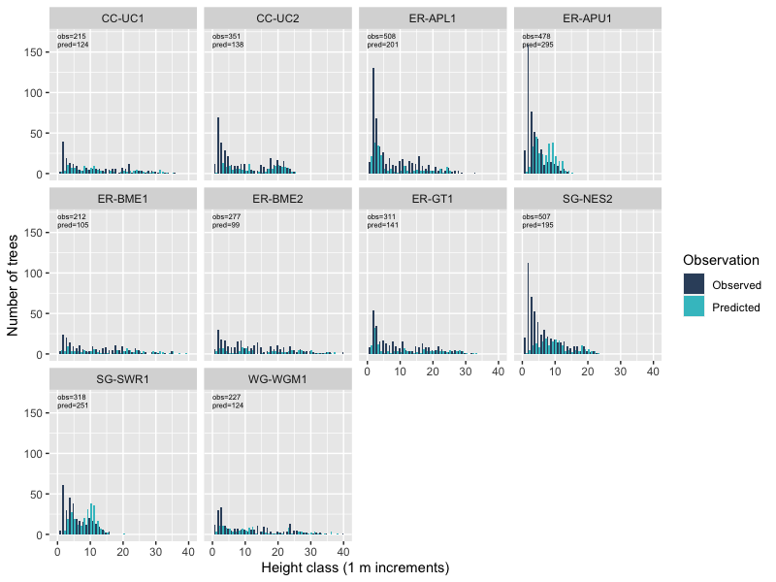
Update with new values from all 17 plots + larger height classes
Flip axes so largest heights are at top of y-axis
Notes:
Flip axes, so that largest heights are at top of Y axis – more intuitive

Slide 8
Add maps of forest structure
Notes:
Add one, or multiple i(i.e., each one I show model prediction for)
Do I drape in a way that shows hillshade or true-color? – or use true-color as one image
Try to get topography in response maps themselves, not separate panels

Slide 9
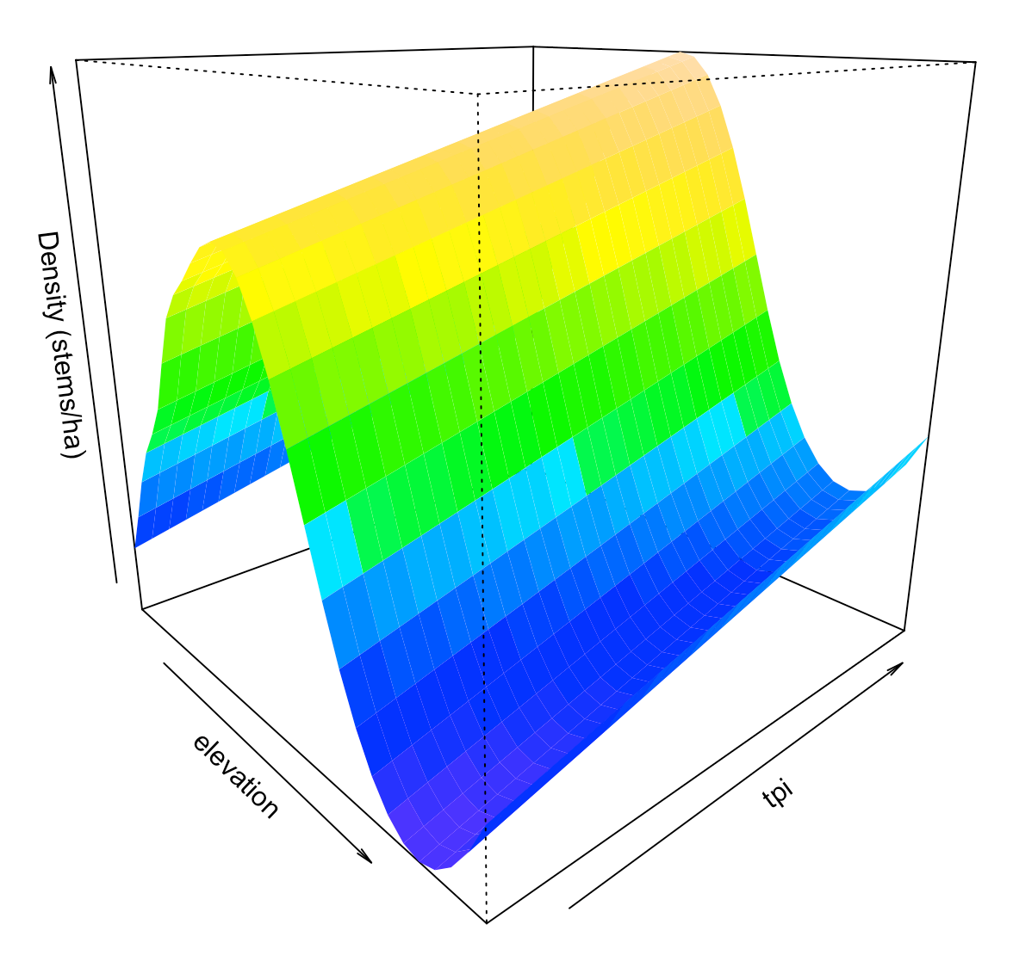
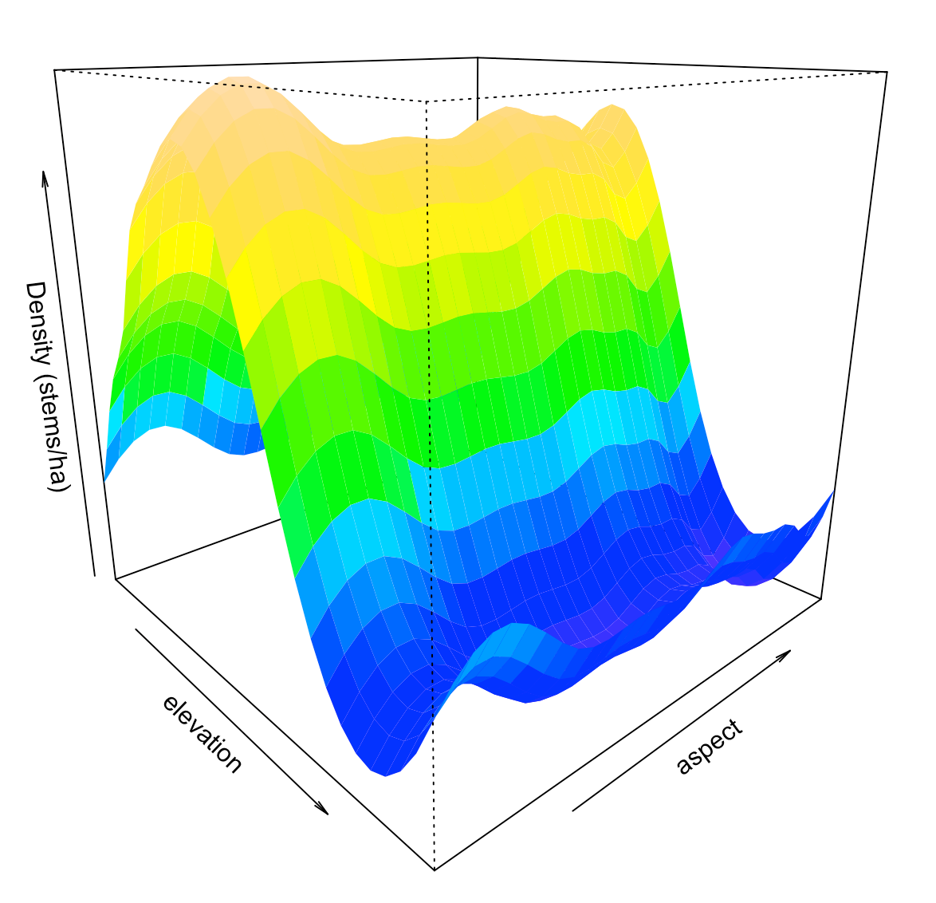
Density v Elevation v TPI
(standardized values)
Density v Elevation v Aspect
(standardized values)
Plot response variable and top two predictors for all response variables
Use contour plot
Notes:
Consider plotting response var and top two predictors for all response variables – more systematic
Table that says all variable strength
Move aspect to supllemental, but explain in text
Explore other response vars more – do same predictors yield different effects, or magnitudes of effect?

Slide 10
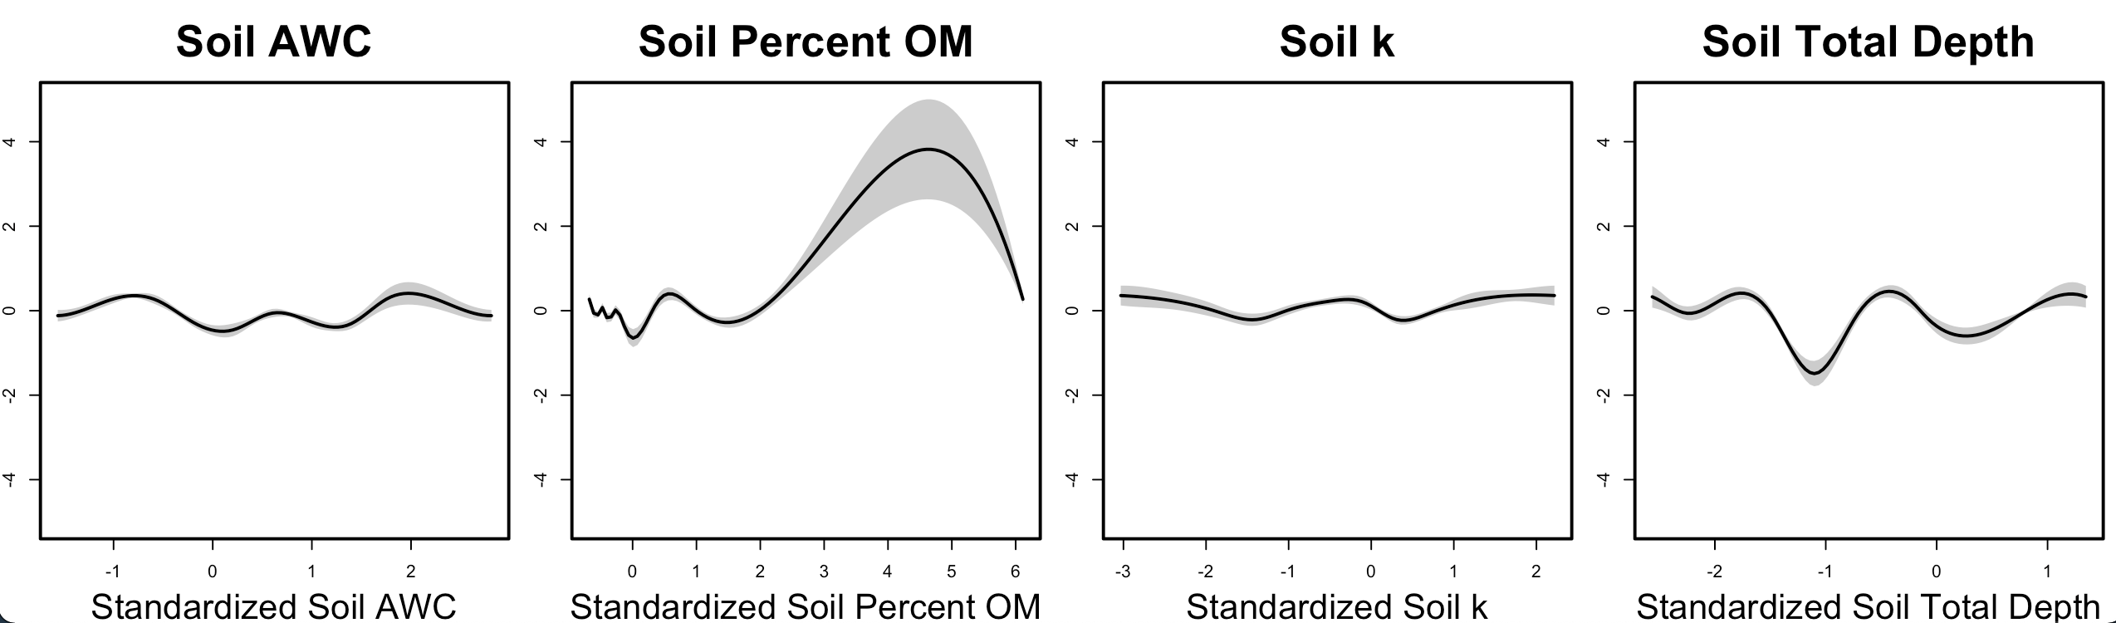
Standardized stand density
Notes:
Highest density at highest OM ... Does this occur at highest elv, where decomp is slowest?
Show all pairwise correlations (scatterplots, corrplot, include soil variables)

Slide 11
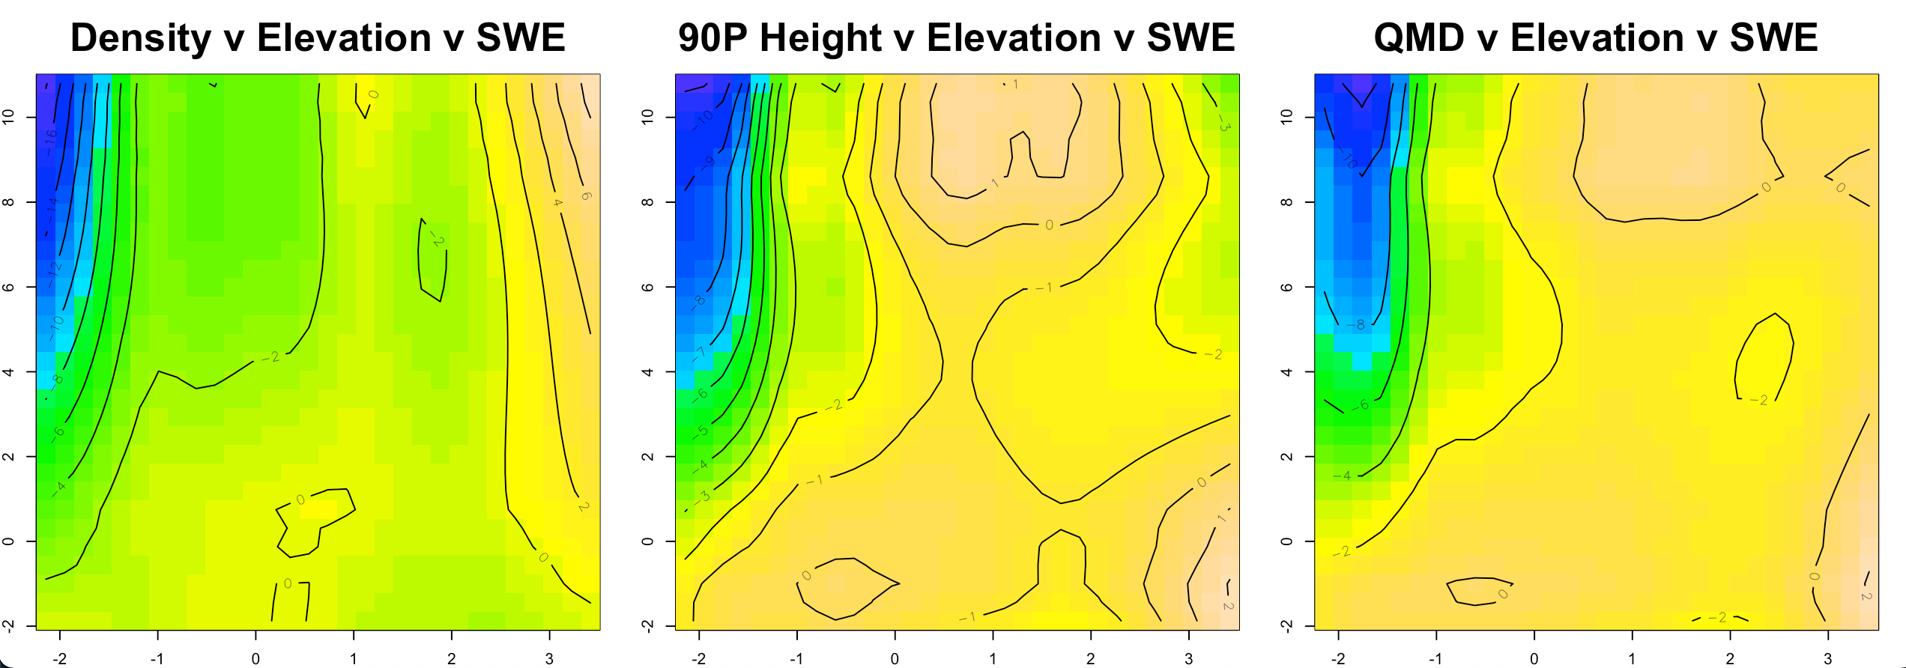
Notes:
Probably go with contour plots for all interaction plots
Put elevation on Y axis
Add basal area figure
If want to focus on swe, maybe include partial-response plot for each response variable
either make point that swe isn’t that strong a predictor, or that it is in a specific way
At low elevations, swe effect is diff than at high elevation

Slide 12
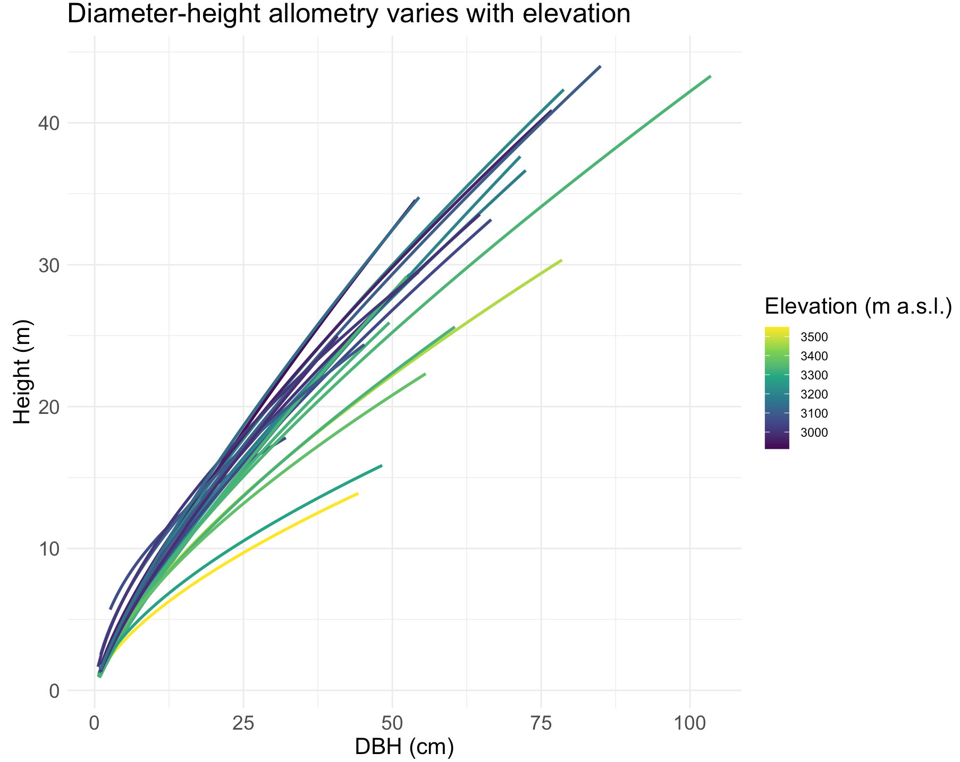
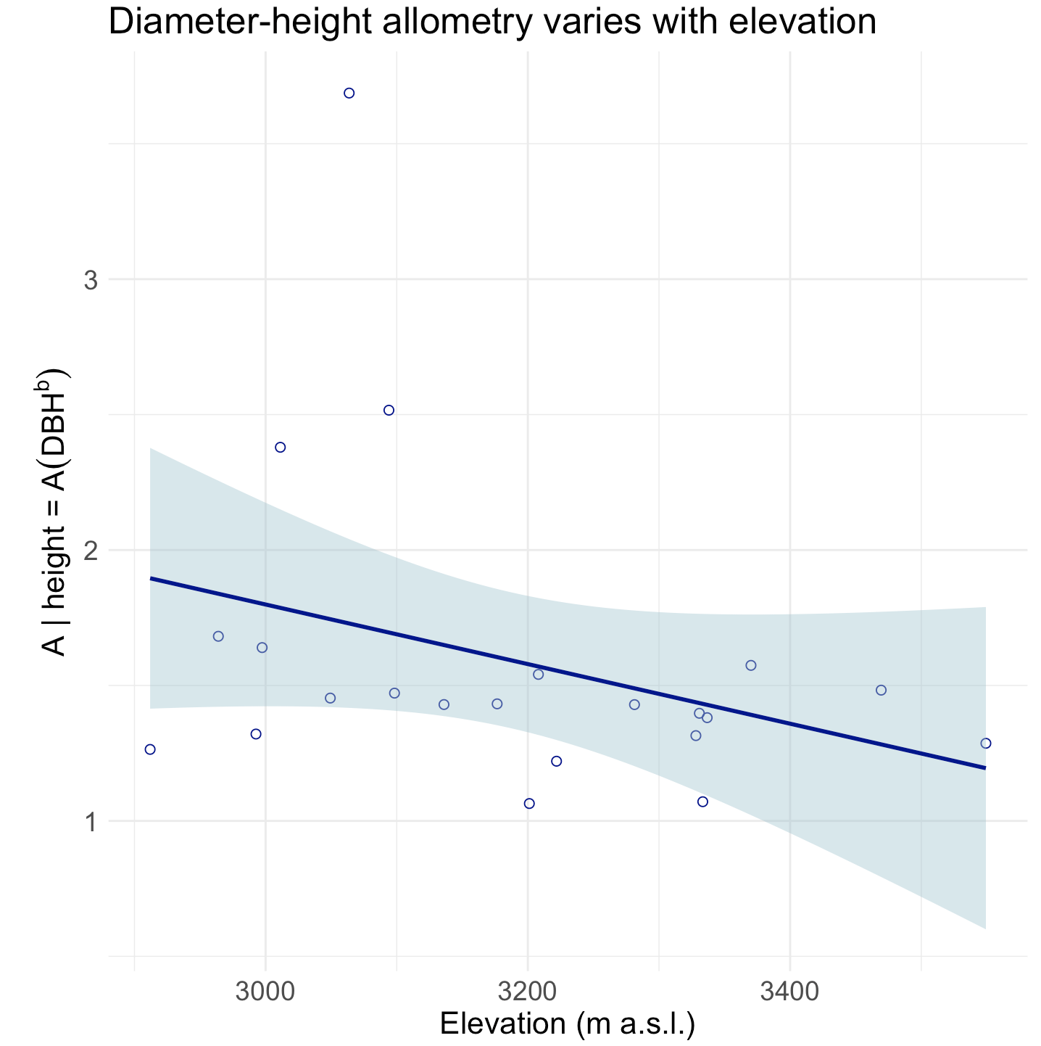
(A)
(B)

Slide 15
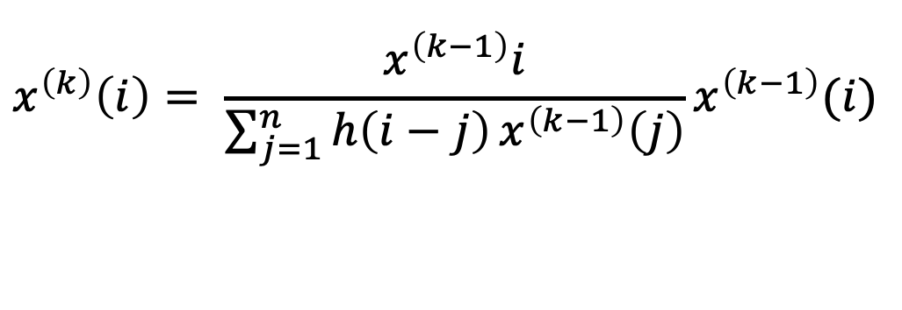
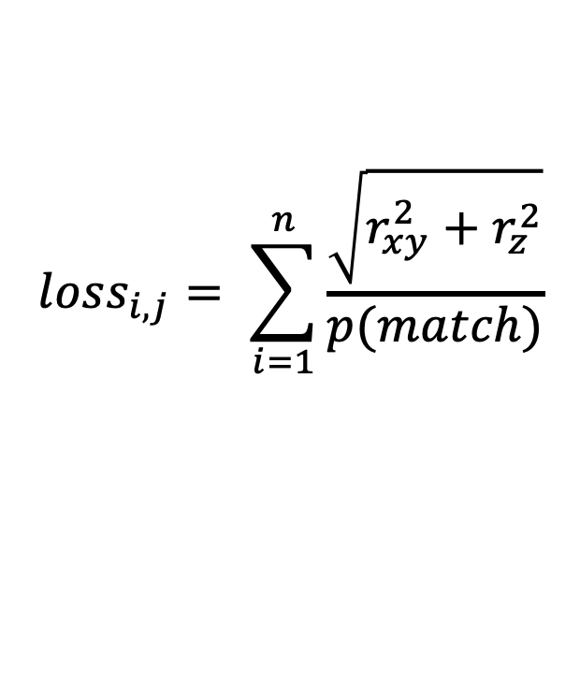
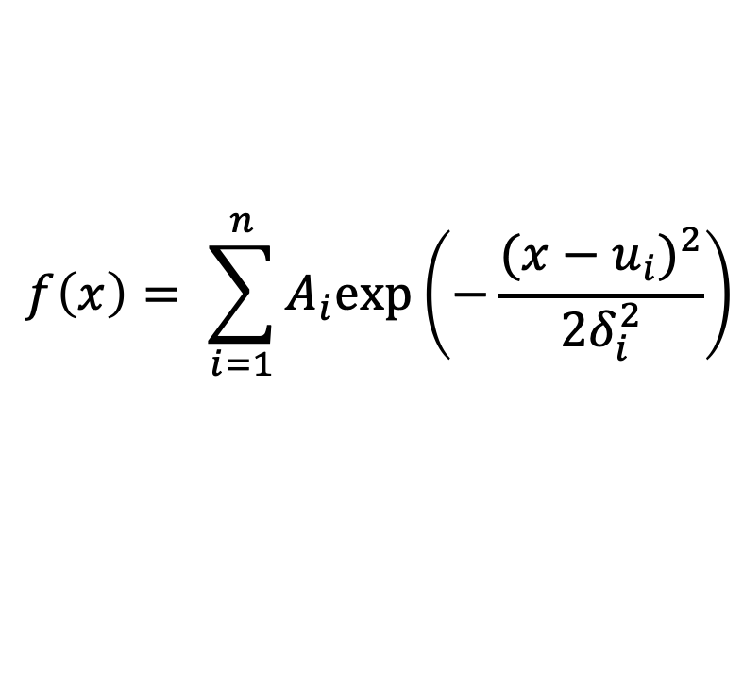
$$x^{\left(k\right)}\left(i\right)= \frac{x^{\left(k−1\right)}i}{\sum_{j=1}^{n}{h\left(i−j\right)}x^{\left(k−1\right)}\left(j\right)}x^{\left(k−1\right)}(i)$$
(1) Gold deconvolution
$$f\left(x\right)= \sum_{i=1}^{n}{A_{i}exp⁡\left(−\frac{{({x−u}_{i})}^{2}}{2δ_{i}^{2}}\right)}$$
(2) Guassian decomposition
$${loss}_{i,j}= \sum_{i=1}^{n}{\frac{\sqrt{r_{xy}^{2}+r_{z}^{2}}}{p(match)}}$$
(3) Loss function for optimizing ITS

